Slide 1
VISUALISATION OF DOMAINS
IN 2D MOLECULAR SYSTEMS
BY BREWSTER ANGLE MICROSCOPE
J. Cirák

Slide 2
CONTENTS
Langmuir monolayer at the air/water interface
Self-organization of molecules in 2D system (theory)
Brewster angle microscope
Maxwell displacement currents measurements

Slide 3
Langmuir monolayers monomolecular insoluble layers of organic amphiphilic molecules formed at the air/water interface during the self-organized process
Systems for the study of self-organization in 2D with the possibility to control thermodynamic state quantities
Formation of Langmuir-Blodgett layers on solid substrates
Study of chemical reactions in 2D molecular systems
Study of phenomena in biological membranes, phase transitions, lipid – protein interactions
Study of interactions between a receptor and a target molecule in biosensor

Slide 4
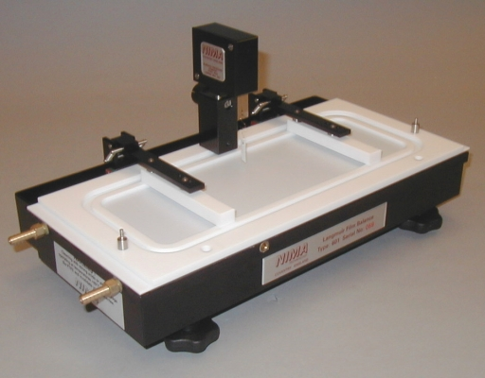
Langmuir trough

Slide 5
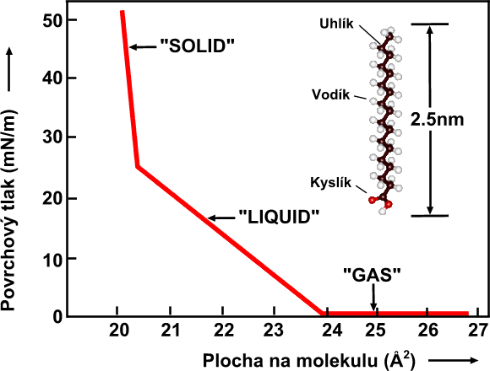
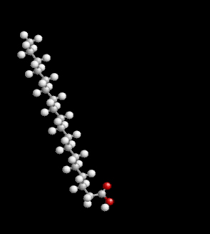
π - Α isotherm of an organic acid monolayer

Slide 6
Lateral domains in Langmuir monolayers
Self-organization in binary mixture of amphiphilic molecules at the air/water interface:
number of molecules in one circular domain
Notes:
6

Slide 7
π – A isotherm of pentadecanoic acid
C
LC
LC/LE
LE
G

Slide 8
Van der Waals equation of 2D molecular system
surface pressure
[mN/m]

Slide 9
π – A isotherm of pentadecanoic acid
C
LC
LC/LE
LE
G

Slide 10
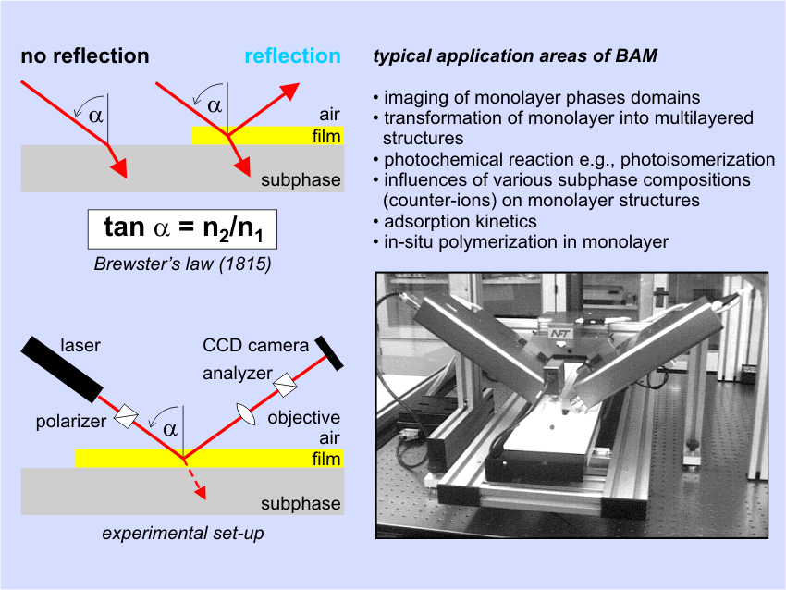

Slide 11
Brewster angle microscopy
1 mN/m
5 mN/m
10 mN/m

Slide 12
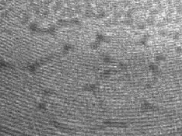
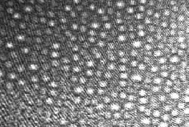
200 μm

Slide 13
Experimental study of physical properties of LB films
Nanoelectric phenomena in Langmuir monolayer

Slide 14
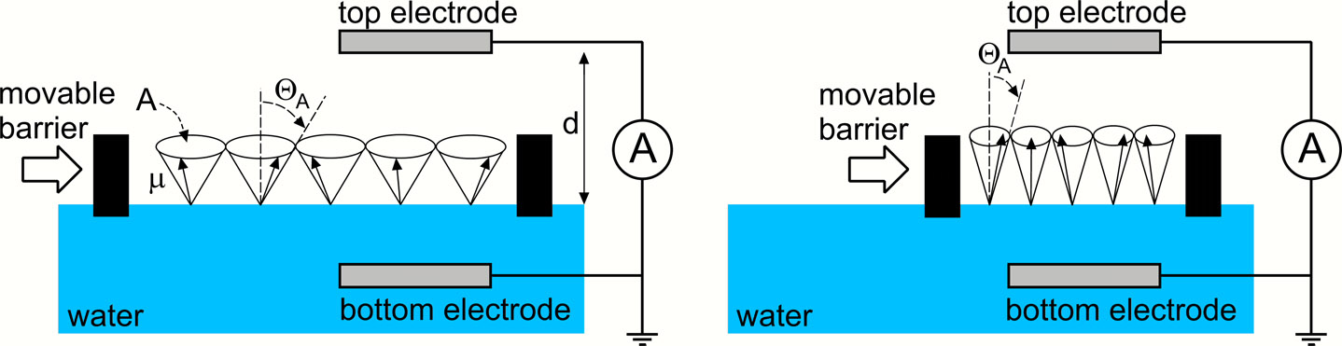
MDC Measurement
Observation of the dynamic response
Change of: a) order
b) dipole moment
c) number of molecules
Notes:
Nomenklatúra pre usporiadanie experimentu.

Slide 15
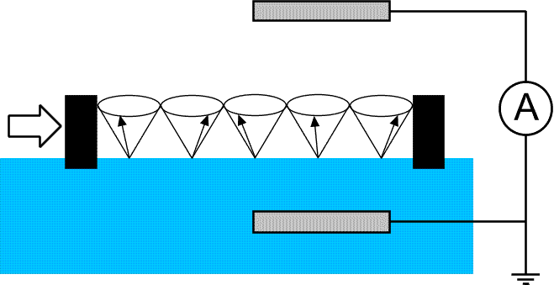
MDC Measurement
Observation of the dynamic response
Change of: a) order
b) dipole moment
c) number of molecules
Notes:
Nomenklatúra pre usporiadanie experimentu.

Slide 16
Orientational order in the Langmuir film with Buckingham’s potential

Slide 17
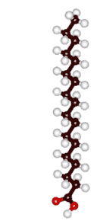
Change in molecular conformation

Slide 18
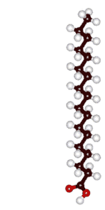
Change in molecular orientantion

Slide 19


Change in molecular charge state

Slide 20



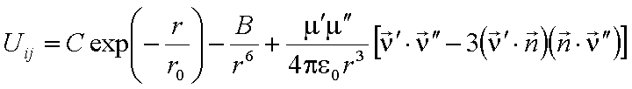

Induced charge
Stat. mean value
Current
Energy
Spatial averaged

Slide 21
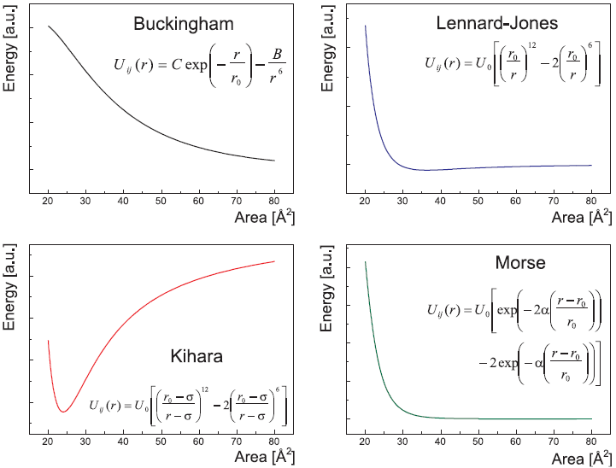

Slide 22
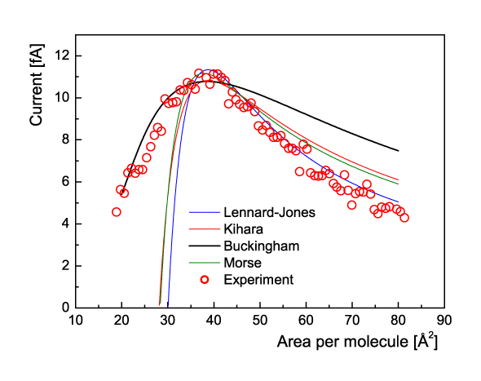
Comparison of calculations using various standard potentials

Slide 23
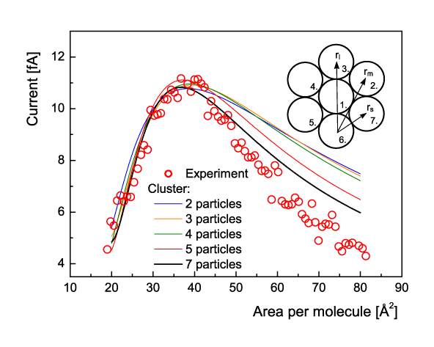
The effect of cluster size

Slide 24
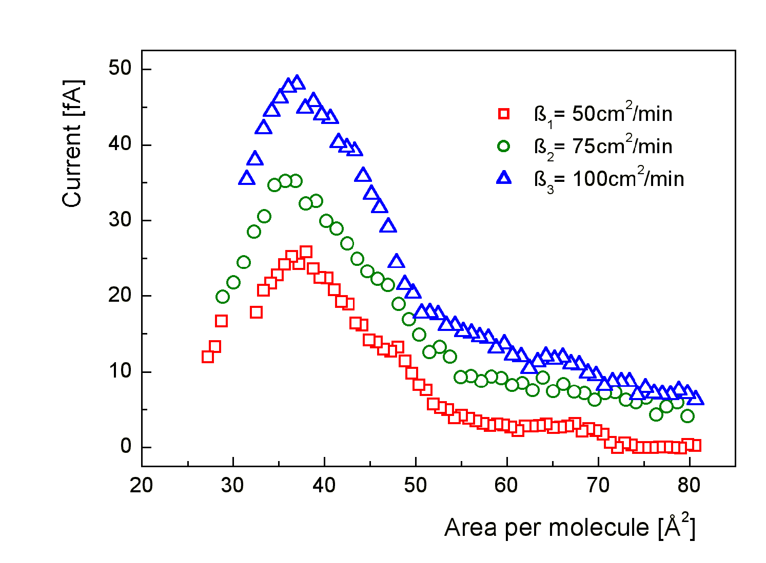
Recordings of MDC signals obtained at three different rates of compression

Slide 25
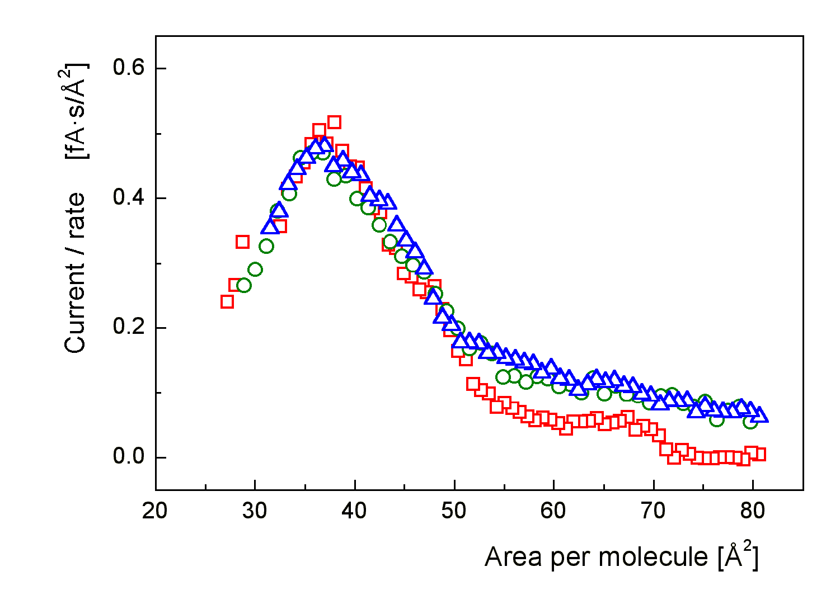
MDC signals replotted as the dependence I/β vs. area per molecule

Slide 26
Conclusions
In soft material science the interest is given to the system composed of several types of molecules where the molecular interactions play a key role in determining the resultant system properties. But the interactions depend on the way how the molecules are spontaneously organized in the system – depend on self-organization. From this point of view LB films can be regarded as an ideal technological tool for modeling basic physical processes in the system with molecular organization.

